Slide 1
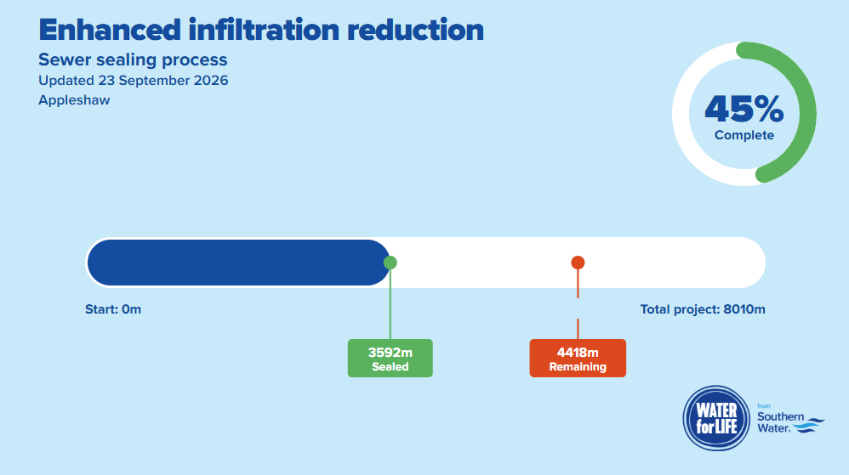
Appleshaw Update
Public – 2796m
Private - 796m
Total - 3592m
Completion: November 2026

Slide 2
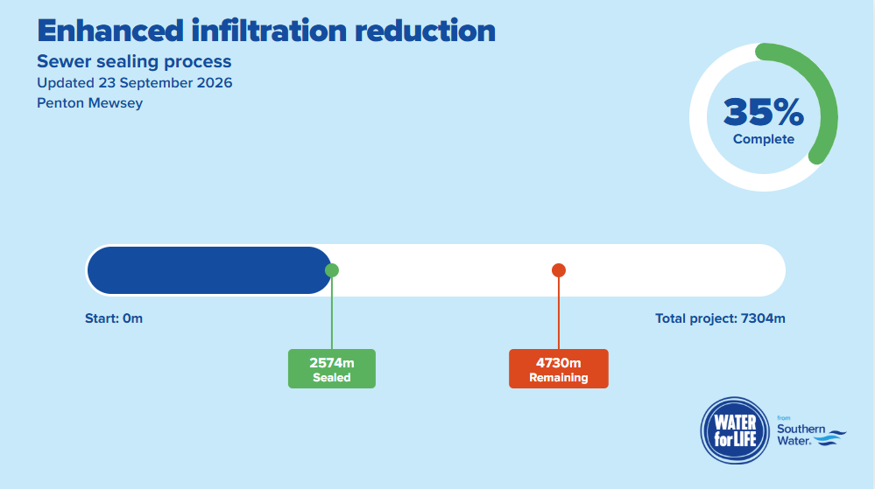
Penton Mewsey Update
Public -2040m
Private - 439m
Total - 2479m
Completion January 27

